Slide 1

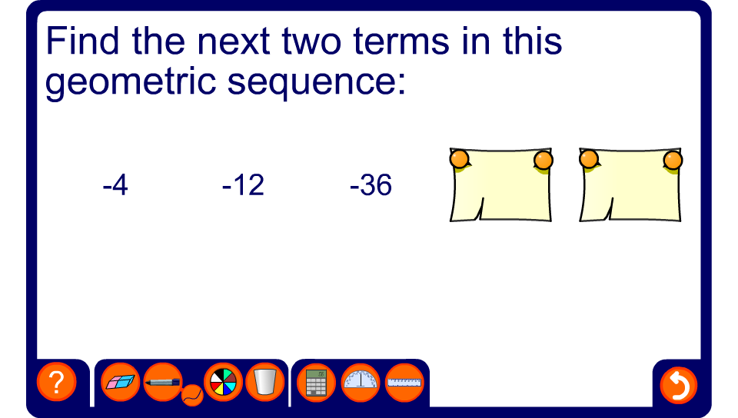


Continuing geometric sequences
Notes:
Start by finding the common ratio by dividing any term by the one before it. Use this to find the next two terms.
None of the common ratios in these examples are negative. Pupils could investigate the effect of have a negative common ratio as an extension activity.

